Slide 1
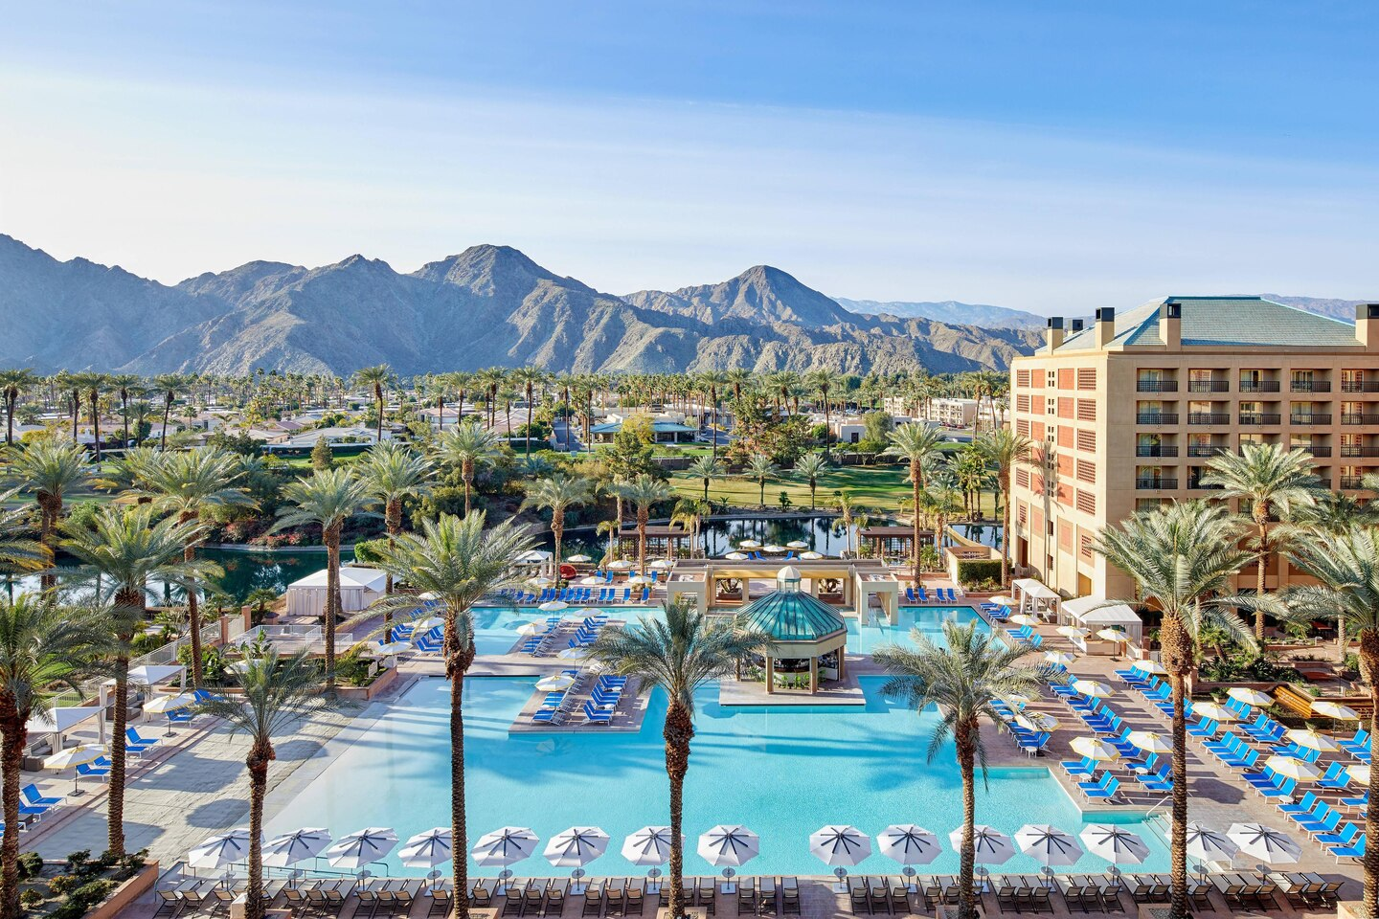
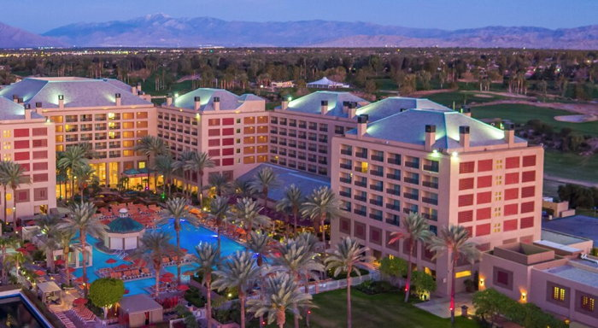
Veterinary dental forum
We cordially invite you to join our veterinary dental professionals at the
38th Annual Conference to experience the finest lectures and labs presented by the top experts in the field.
Past Programs Included:
1,300+
Veterinarians, Technicians, and Vendors
24
CE Hours - Scientific Sessions - Laboratories
CONFERENCE HIGHLIGHTS
Lectures:
Advanced
Brief Clinical Reports
DEI/Practice Wellness
Equine
Fundamentals
Intermediate
Original Research
Specialist-in-Training
Technician
Labs:
2-and-4-Hour Labs Available
Also:
Extractions
Radiography
Orthodontics Anesthesia
and Much More...
PALM SPRINGS, CA, SEPTEMBER 25-28, 2024
www.VeterinaryDentalForum.org

